Slide 1
Error-Hiding Design Anti-Pattern
Debashis Jena
UMGC – SWEN 656 (Fall 2020)

Slide 2
Error-Hiding Design Anti-Pattern
A type of design anti-pattern where, the exceptions are caught but they are not logged or processed or reported to any other parts of the system.
Sometimes the errors are logged incorrectly; for example in Java if an error is logged as logger.info(error) instead of logger.error(error), then it is also a pattern of error-hiding.
Error-hiding is also known as error-swallowing or exception-swallowing.
This is an anti-pattern, since it results in suppressing the errors or exceptions within the execution results itself and difficult to be recognized during debugging.

Slide 3
Why Handle Exceptions?
Helps in tracking down the bugs or errors that may arise unexpectedly
Prevents erroneous screen messages that may be visible to the end user which may not make any sense to them
Keeps away the showstopper issues like dead locks or any other catastrophic program failures that may leave the software in an unstable state
In case of catastrophic issues, it helps the system to take alternate ways to perform the required tasks

Slide 4
Scenarios – Error-Hiding causes
Temporary exception handlers – In attempt to keep supporting the called method signature exception changes, the developer may end up adding an exception swallowing as a temporary measure.
Nested exception handling – Having nested try-catch blocks may result in hiding the errors in the nested code.
Blanket catch of exceptions – While trying to prevent crashes at all cost, the programmer may enclose an entire API function within a try-catch block, it hides some of the errors that the called methods or subroutines may have.
Generic error – While performing the translation of the technical errors into user-friendly error messages, developers may group them into a generic errors like “Internal server error”. This may lead to user messages being completely useless, failing to convey what exactly went wrong.

Slide 5
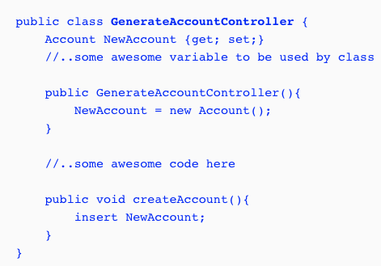
Sample Code – Error without Exception Handling
Let's take an example in Salesforce Apex.
Salesforce MVC architecture has Visualforce pages as frontend and the apex controller classes as the backend server-side code.
GeneralAccountController apex class captures the new account information and inserts into the database.

Slide 6
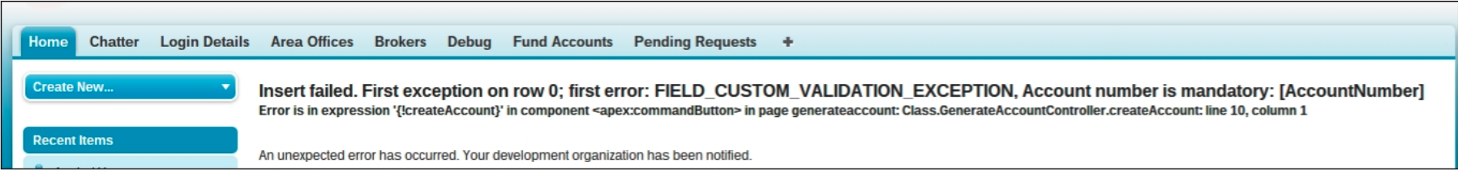
Sample Code – Error without Exception Handling
In Salesforce, there can be additional custom validations, which rejects an invalid input.
Let’s say, in this example, the AccountNumber is being validated with a custom validation rule.
As can be seen, some of the basic required fields are missing as the input.
System throws an exception while inserting and it shows as a broken page to the end user, as below.

Slide 7
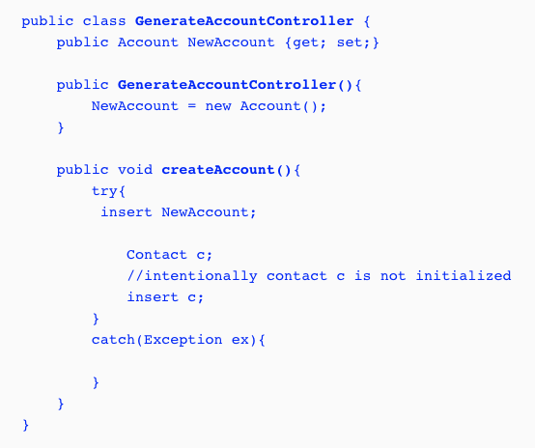
Sample Code – Exception Handled with Error-Hiding
GeneralAccountController apex class now has a try … catch block.
It is a good start, since it will not throw any error to the end-user.
However, the end user will not know what exactly happened, since the application is not showing any errors or any success message.
This is the catch block is empty.

Slide 8
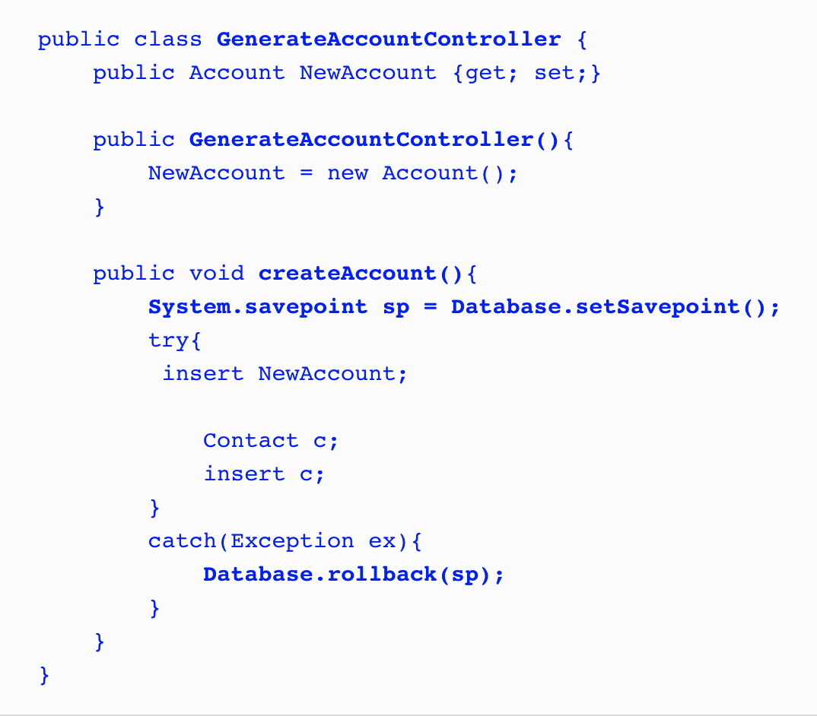
Sample Code – Error-Hiding Removed
As the example here inserts an Account with a contact.
In this scenario, there is a possibility that the account may get inserted but not the contact.
As an account is not supposed to be saved partially without a contact, the code snippet here creates a SavePoint and rolls back when there is an exception. Database.rollback(sp) ensures the error-hiding anti-pattern is removed.
User may optionally add a log in the catch block.

Slide 9
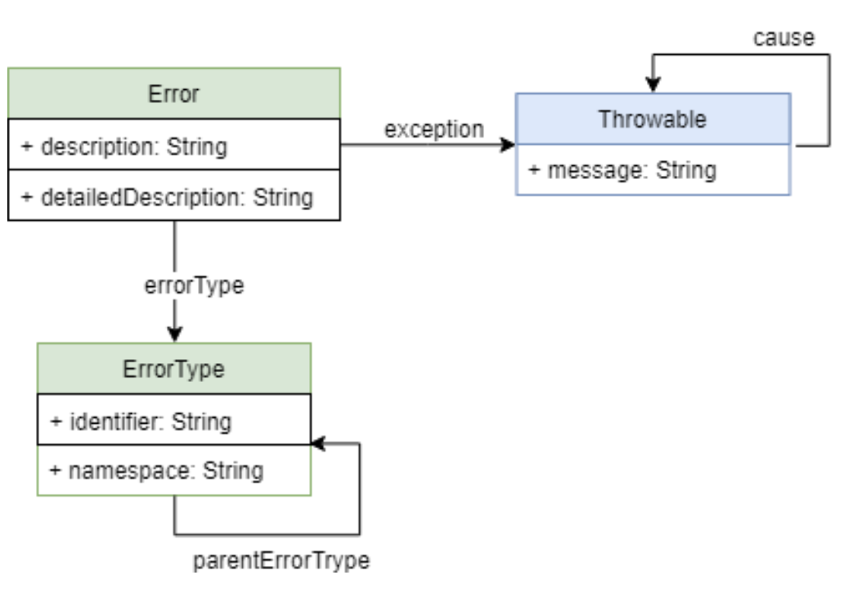
UML – Exception Handling
Typically on errors, developers tend to apply the exception handling techniques.
However, it is very important to add a fall back alternative or log the error in the catch part of the exception.
Error-hiding occurs when the catch part of the exception is left blank.

Slide 10
Pros & Cons
Pros :
A temporary use of error hiding helps developer to get around the issues quickly.
It prevents the application to crash abruptly.
Generic error pages helps preventing the user seeing a broken page with cryptic errors.
Cons :
Without proper logs, developers become paralyzed while trying to debug a certain issue.
With a blanket exception handling, the exact issue gets hidden.
With error-hiding anti-patterns, the rollback plans are not possible in case of exceptions.

Slide 11
Reference
No Author. (n.d.). Error-hiding. Retrieved from https://en.wikipedia.org/wiki/Error_hiding
Zaa, J. & Verma, A. (2016). Apex design patterns. Retrieved from https://learning.oreilly.com/library/view/apex-design-patterns/9781782173656

